Slide 1
Amazon Elastic Container Service (Amazon ECS)
Run highly secure, reliable, and scalable containers

Slide 2
What is a Container?
Containers provide a standard way to package your application's code, configurations, and dependencies into a single object. Containers share an operating system installed on the server and run as resource-isolated processes, ensuring quick, reliable, and consistent deployments, regardless of environment.

Slide 3
Why Amazon ECS?
Amazon Elastic Container Service (Amazon ECS) allows you to easily deploy containerized workloads on AWS. The powerful simplicity of Amazon ECS enables you to grow from a single Docker container to managing your entire enterprise application portfolio.

Slide 4
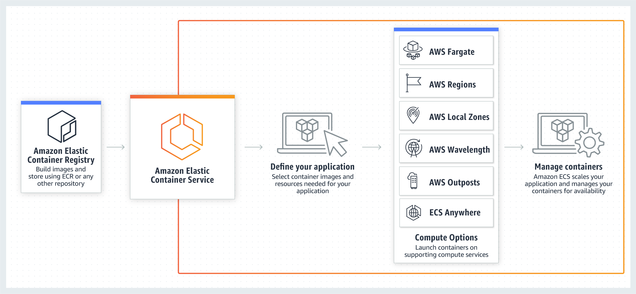
How it works Amazon ECS is a fully managed container orchestration service that makes it easy for you to deploy, manage, and scale containerized applications.

Slide 5
cluster
Create a cluster
Cluster Configuration
Networking
Infrastructure
Select “create”

Slide 6
Task definition and Container
Task definition configuration and Container creation
Container
Step-1
container details
port mappings
Step-2
configure environment
storage
Step-3
review and create

Slide 7
Use cases
Support batch processing
Plan, schedule, and execute batch computing workloads across the full range of AWS services, including Amazon Elastic Compute Cloud (EC2), Fargate, and Amazon EC2 Spot Instances.
Scale web applications
Automatically scale and run web applications in multiple Availability Zones with the performance, scale, reliability, and availability of AWS.
Deploy in a hybrid environment
Build container-based applications on-premises or in the cloud with Amazon ECS Anywhere and enjoy consistent tooling, management, workload scheduling, and monitoring across environments.

Slide 8
i

Slide 9
Any questions?

